Slide 1
Development of a Small Scale ROV for Research Purposes
Joshua Hecke
n11585382

Slide 2


Slide 3
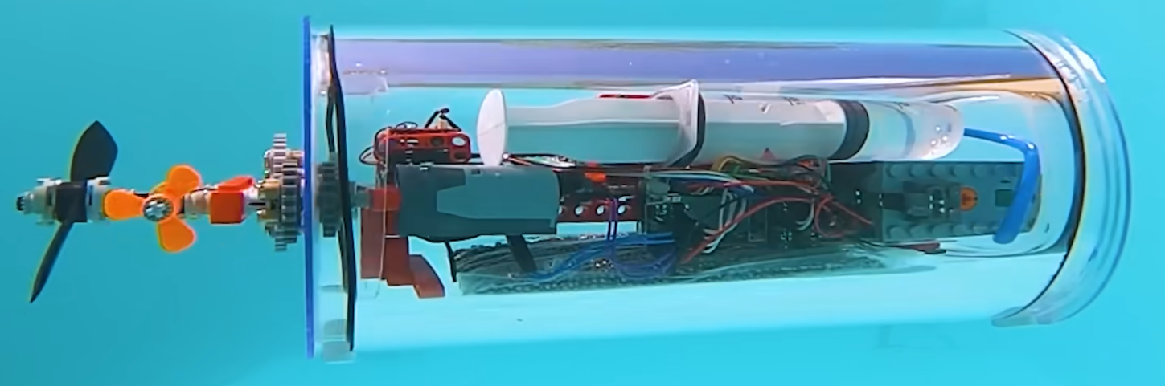
Project Overview
The final demonstrator should include:
Perform pre-programmed missions including data collection.
Help Complement ongoing research with our BlueROV ROV by providing a cost-effective platform
Help guide algorithm development, open day demonstrations, and initial machine learning pipeline testing.
Task Description:
This project involves designing, building, and programming a miniature autonomous underwater vehicle to serve as a demonstrator for educational outreach and testing platform for underwater robotics research. The objective of this project is to create a small-scale submersible capable of controlled diving, surfacing, and maneuvering in test tanks or demonstration pools.
Photo of suggested approach by supervisor
Notes:
Bold for titles

Slide 4
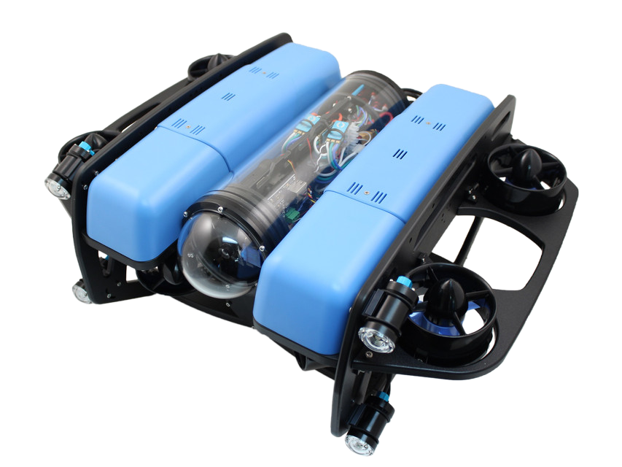
Project Breakdown
Research Topic: Development of a Small Scale ROV for Research Purposes
Research Question: How can a modular, small-scale ROV platform be developed using primarily Commercial Off-The-Shelf components to create a cost-effective and adaptable tool for undergraduate-level robotics education and system testing?
Research Problem: Currently the BlueROV2 ROV that QUT owns is too large and use requires additional steps including
QUT pool approval and/or offsite setup
Difficult manual handling
This larger platform can be overkill for small tests
This project aims to design a smaller solution which directly solves these problems
?
Notes:
Bold for titles

Slide 5
Literature
Review
~60-70 papers were identified

Slide 6
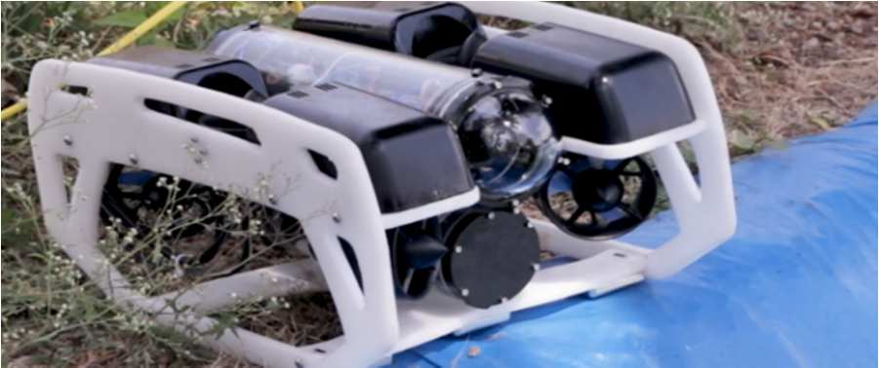
Modular Observation ROV(BlueROV2)
ROV Focus: Based on components mentioned, likely references the BlueROV2 or similar, focusing on surveillance, inspection, and mapping.
Design Philosophy: Emphasizes modularity, stabilized frame, ease of operation, and high maneuverability with 5 Degrees of Freedom (DOF) using vectored thrusters.
Key Technologies:
Controller: Raspberry Pi with Pixhawk running ArduSub.
Structure: Open-frame structure; polyurethane foam for buoyancy.
Propulsion: Six thrusters (4 vectored horizontal, 2 vertical) with integrated ESCs.
Sensors: Cameras, depth, temperature, pressure sensors. Suggests future addition of SONAR.
Communication: Tether with Fathom-X interface boards (Ethernet).
Power: Lithium-polymer battery pack.
Relevance to Small Scale: The modular hardware (Pi, Pixhawk) and open-source software stack is directly applicable and scalable to smaller designs. The 6-thruster vectored configuration is effective for maneuverability in smaller frames.
Photo of the rov used in the paper
Jothikrishna et al. (2023)

Slide 7
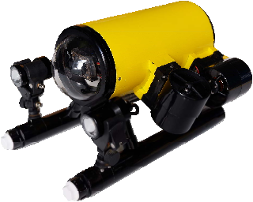
ArduinoSub: Leveraging Low-Cost Components for Education
ROV Focus: ArduinoSub, an observation-class ROV designed as an educational kit for middle school to university students.
Design Philosophy: Prioritize low cost (under $1000) and accessibility by using Commercial Off-The-Shelf (COTS) parts wherever possible.
Key Technologies:
Controller: Arduino Mega 2560
Structure: Polyethylene pipes.
Propulsion: Four thrusters with integrated ESCs
Sensors: Includes a 9-axis IMU (MPU-9250) and a depth
sensor (MS5837-30BA).
Camera: Analog HD CCTV camera mounted on a tilt servo.
Power: Powered by eight 21700 lithium-ion batteries in a
4S2P configuration, housed in external tubes.
Relevance to Small Scale: Demonstrates a successful low-cost approach using accessible Arduino platform and COTS materials, highly relevant for budget-conscious small ROV projects.
Photo of ArduinoSub
Wang et al. (2019)

Slide 8
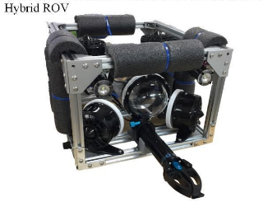
Hybrid ROV - Capstone Project
ROV Focus: Small-scale educational Hybrid ROV for shallow channel survey/exploration and MATE competitions. Operates tethered (manual) and tetherless (autonomous).
Design Philosophy: Educational platform for underwater robotics, enabling dual ROV/AUV modes and sensor data collection, including autonomous depth profiling.
Key Technologies:
Controller: Raspberry Pi Zero W (ROV), Raspberry Pi 3 B+ (Base Station).
Structure: Aluminum extrusion frame, waterproof enclosure.
Propulsion: Six thrusters with ESCs and 16-Channel PWM/Servo Driver.
Sensors: IMU, GPS, Pressure, Sonar, Water temperature.
Camera: 2.1 MP HD-SDI Camera, two LED lights.
Power: 12V Battery pack; tether-powered option.
Communication: Detachable tether, WiFi (surfaced).
Relevance to Small Scale: Robust, modular aluminum frame for prototyping. Hybrid tethered/tetherless design demonstrates small platform flexibility. Uses accessible components (Raspberry Pi, standard sensors).
Photo of the rov designed in the paper
Hur, B., & Alvi, M. (2022)

Slide 9
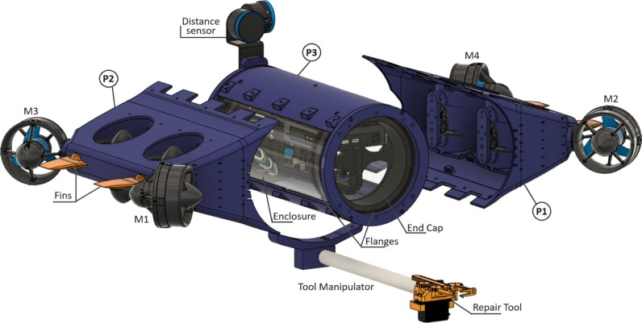
Hybrid AUV/ROV for Aquaculture
ROV Focus: Kalypso, a hybrid Autonomous Underwater Vehicle (AUV) and Remotely Operated Vehicle (ROV) designed for aquaculture inspection and intervention in the Mediterranean.
Design Philosophy: Enhance aquaculture management via dual modes: AUV for autonomous net inspection and ROV for teleoperated intervention. Prioritizes cost-effectiveness through 3D printing.
Key Technologies:
Controller: Pixhawk board, Raspberry Pi 3, Mini PC.
Structure: 3D printed main body, acrylic tube WTE
Propulsion: Eight thrusters providing 6 Degrees of Freedom (DOF).
Sensors: Leak sensors, underwater ultrasonic sensors, twin cameras
IMU, compass, distance sensors
Power: Two 14.8V, 10,000 mAh LiPo batteries.
Software: Custom navigation algorithms and vision-based hole
detection procedures.
Relevance to Small Scale: 3D printing provides adaptable, cost-effective construction for custom small-scale ROVs. The multi-board control architecture, distributing tasks across processors, is scalable to smaller platforms.
Photo of the rov design
Manos et al. (2024)

Slide 10
Motivation and Objectives
Motivation/Rationale:
Address the distinct gap in accessible, low-cost, and modular small-scale ROVs that are computationally equipped for modern research.
Large, work-class vehicles are often financially and logistically prohibitive for academic research and rapid prototyping.
The primary objective is to create a versatile testbed for novel Machine Learning (ML) control pipelines and for use in QUT demonstrations.
Research Objectives:
Develop and test a small scale rov design that can be used to test ML pipelines, in demonstrations on open days and possibly carry small payloads.
Create a digital model of the design so buoyancy, equations of motion can be simulated in more detail in the future
Document and report the design process and outcomes with plans to open source solutions
Notes:
Dynamic for each side

Slide 11
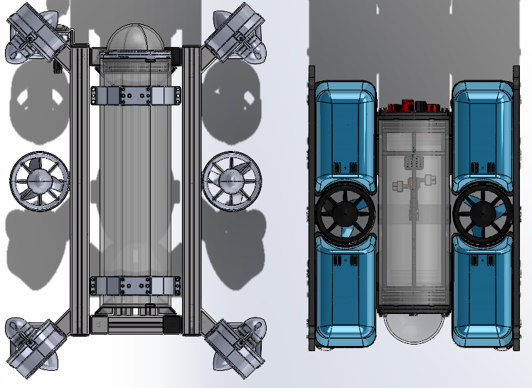

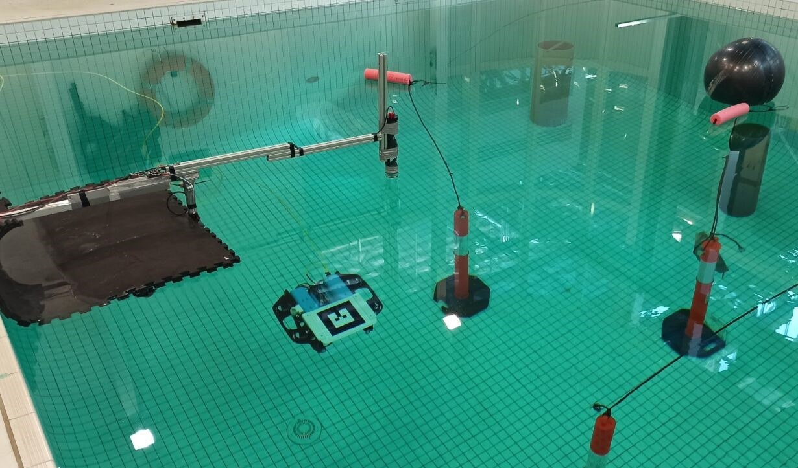
A Three-Phase Approach to Reach
Outcomes
Phase 1: Research and Design
Research: Research components and materials used in current solutions
Development: Iteratively design a first stage solution that meets research outcomes
Phase 2: Simulation and Prototyping
Simulation: Produce a digital twin that allows simulation of buoyancy and motion in ros2 using Solidworks documentation
Prototyping: Develop a second stage refined design based off simulation results
Phase 3: Reporting, Testing & Refinement
Testing: Conduct waterproof tests, Manual motion tests and possibly autonomous identification tests
Refinement: Use test results to refine a third stage solution that has evidence meeting research outcomes.
Reporting: Document all outcomes and finalize outcomes into a accessible package(Github repo)
Notes:
Dynamics for each phase

Slide 12
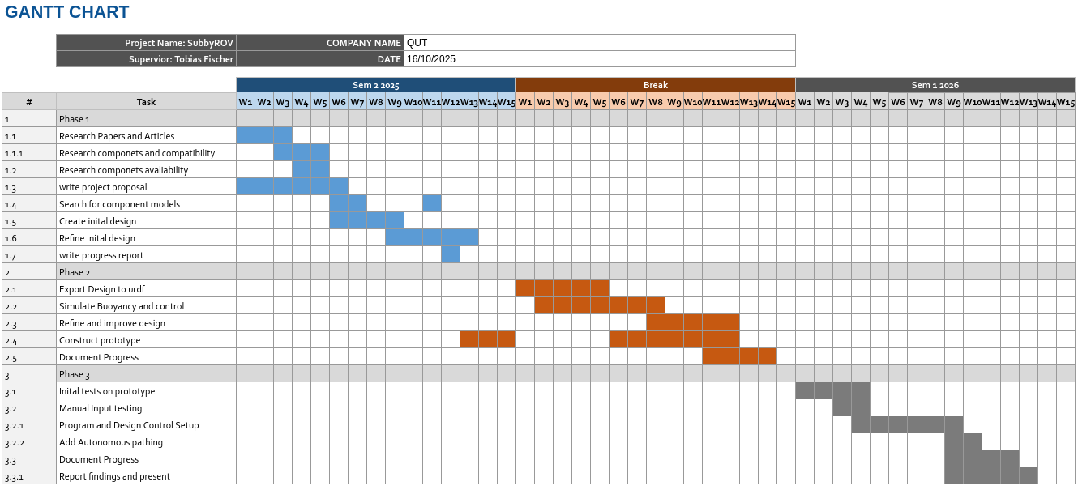
Project Gantt Chart

Slide 13
Project Progress
Phase 1

Slide 14
Research
Comprehensive Literature Review
Completed a review of existing ROV designs, informing key design themes and philosophies.
Identified a gap for small-scale, low-cost platforms suitable for research.
Adapted the plan based on new literature half way through design iterations, moving from a 6-thruster to a 4-thruster design to meet size and power constraints.
Component Research
Components discovered from the literature review were research for suitability and accessibility.
Components were also investigated for the compatibility with the desired approach.
This was then reviewed half was through the design iterations and adjustments were made. The effect was the removal companion computer and internal ESC to meet sizing constraints
Notes:
Dynamics for each phase

Slide 15

Milestones
Key Milestones Achieved
Submitted a comprehensive Risk Assessment (ID: 18339) to the QUT HSE Hub.
Completed multiple design iterations in SolidWorks 2023.
Produced a detailed Bill of Materials (BOM)
Began initial construction and assembly of the watertight enclosure (WTE) prototype.
Notes:
Dynamics for each phase

Slide 16
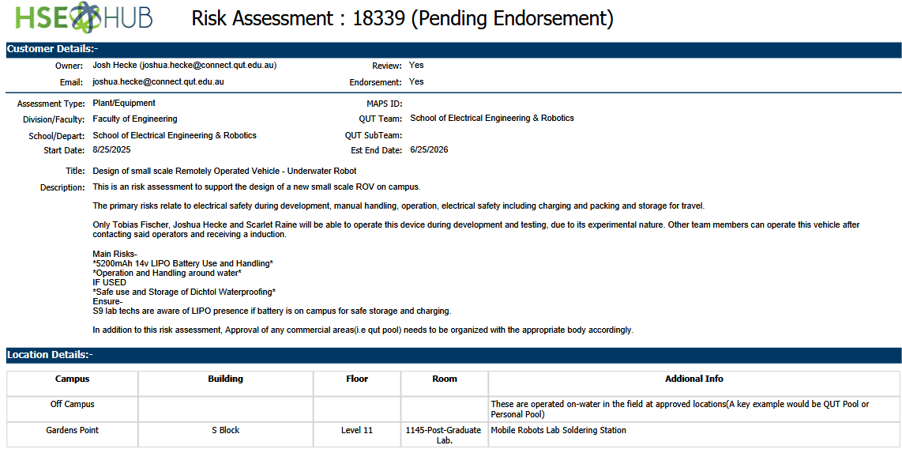
Risk Assessment

Slide 17
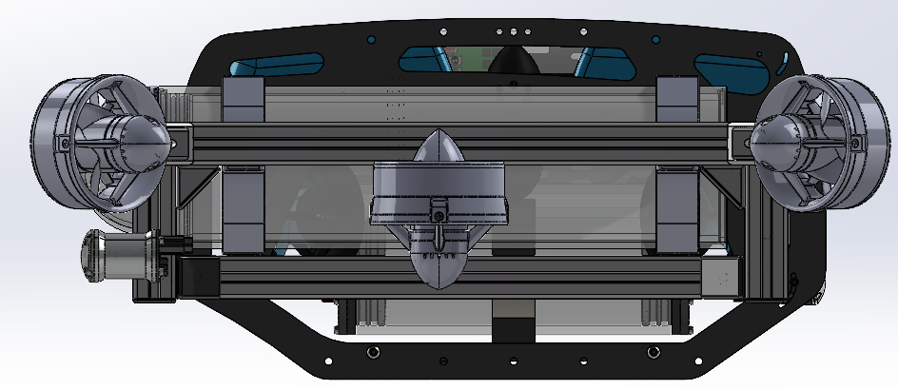
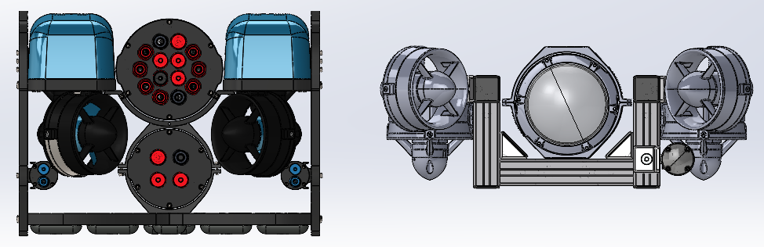
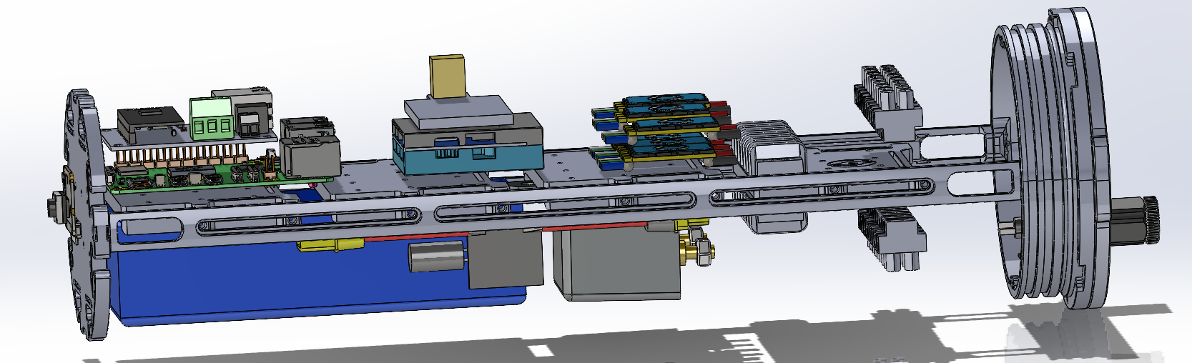
Design Iterations #1
Notes:
Dynamics for each phase

Slide 18
Review of Designs 1
Initial Concept (Design 1)
Designs started with a 6-thruster vectored
Aluminium Item to mount thrusters
4” diameter enclosure at 300mm length
Use of Pixhawk 6C mini
Use of large 18000mAh lithium-ion battery
Novel Battery switch using automotive relay
3D printed parts to reduce purchasing costs
Supervisor Feedback & Redesign
After meeting the supervisor said the design is too large
Detail explanation as to why the size was to big relative to the suggested approach from slide 1
Need to reduce external profile
Key outcomes
Smaller external profile required
Notes:
Dynamics for each phase

Slide 19
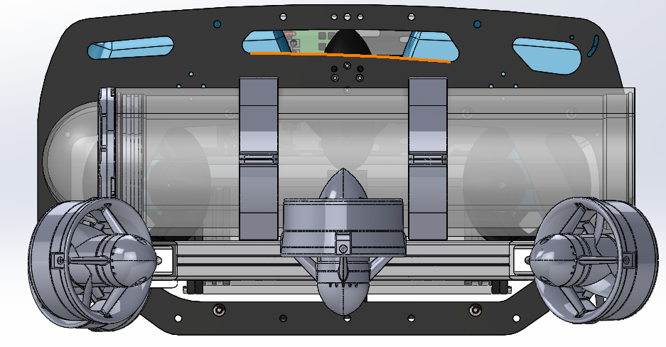
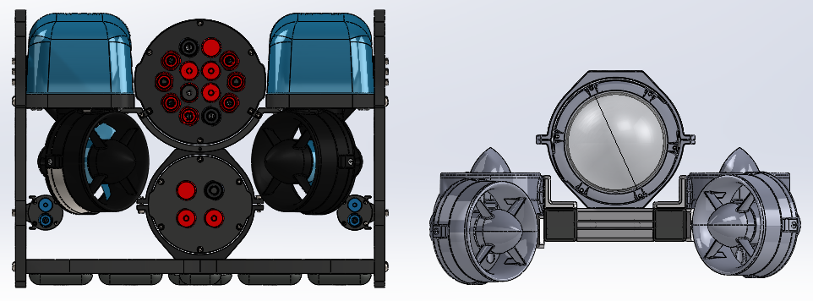
Design Iterations #2
Notes:
Dynamics for each phase

Slide 20
Review of Designs 2
Supervisor Feedback & Redesign
A meeting resulted in a major design pivot.
Key changes: Reduce thrusters to 4, research smaller thrusters, remove companion computer and go straight to ground control, ESC outside of WTE, smarter 6X autopilot to replace companion computer
Due to the size reduction the Li-ion battery is now too large and a more energy dense LiPo battery is required.
Initial Concept (Design 2)
Similar internal makeup however changes to the external profile made to reduce size
Key outcomes
Less components inside WTE
Smaller battery for smaller thrusters
Notes:
Dynamics for each phase

Slide 21
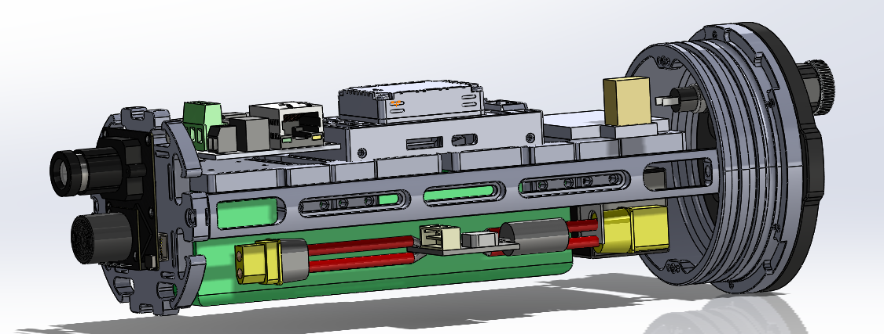
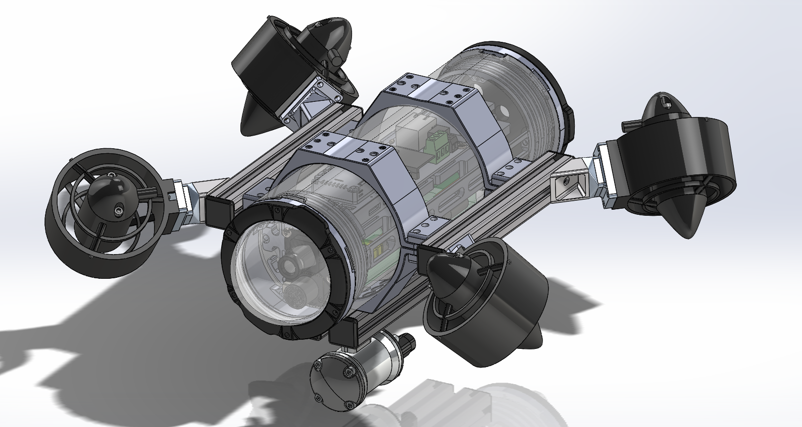
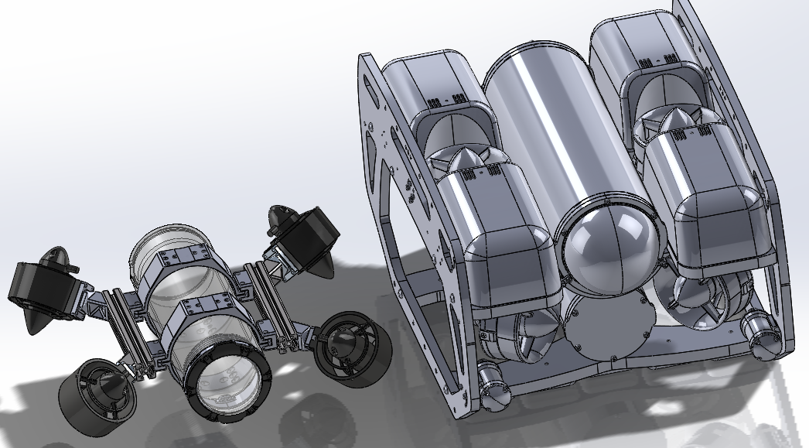
Design Iterations #3
Notes:
Dynamics for each phase

Slide 22
Review of Designs 3
Initial Concept (Design 3)
This design now uses a 5400mAh LiPo battery
The design is centered on a Blue Robotics 3" diameter watertight enclosure which reduces profile margin
It features an experimental 45-45 degree bracket for the 4 thrusters to provide vectored force.
New camera as companion computer is now removed
New thrusters with smaller profile and external waterproof ESC
Core New Electronic Components
Main Controller: Pixhawk 6X flight controller.
Propulsion: 4x APISQUEEN U2 MINI thrusters with ESC.
Camera: Px4Flow
Power: Tattu 5200mAh 4S (14.8V) LiPo battery.
Key outcomes
Px4Flow outdated
Missing handling points
Notes:
Dynamics for each phase

Slide 23
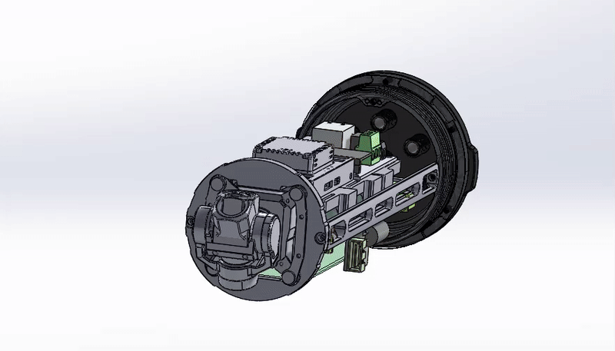
Design Iterations #4

Slide 24
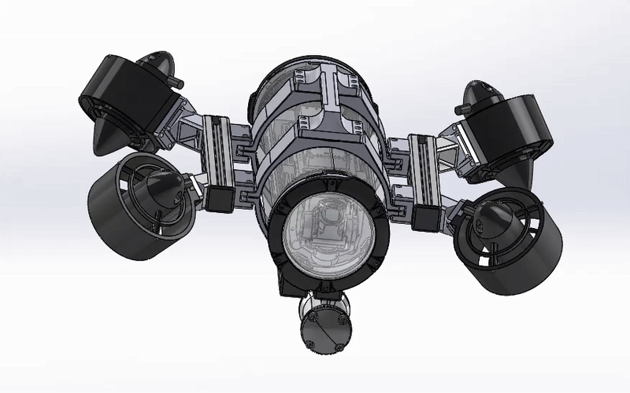
Design Iterations #4

Slide 25
Review of Designs 4
Final SolidWorks Model
New camera mount as design 3’s camera was unsourceable
Smaller relay as battery demand has decreased
New handle for easier Handling
Camera: Z-1 Mini gimballed camera.
Next Steps for the Design
Validate the designs buoyancy through simulation and add additional volume according to simulations
Investigate wire connections inside WTE
Design Ground station connection
Investigate Experimental 45-45 mount
Prototype to validate custom 3D printed mounting solutions
Notes:
Dynamics for each phase

Slide 26
Procurement & Initial Prototyping Status
Bill of Materials (BOM) & Procurement
A full BOM has been produced.
Total estimated cost for all components is currently at ~$3000.
All critical long-lead items have been received, including the flight controller, thrusters, and enclosure components.
Mounting hardware is on order; the power sensor is on reorder.
Initial Prototype Assembly
To validate the SolidWorks design, the initial construction of the WTE has started.
The internal electronics tray has been assembled, mounting the Pixhawk 6X, PDB-XT60, and Fathom-X boards.
This test-fitting confirmed the components fit well, with only minor modifications needed for mounting holes.
Notes:
Dynamics for each phase

Slide 27
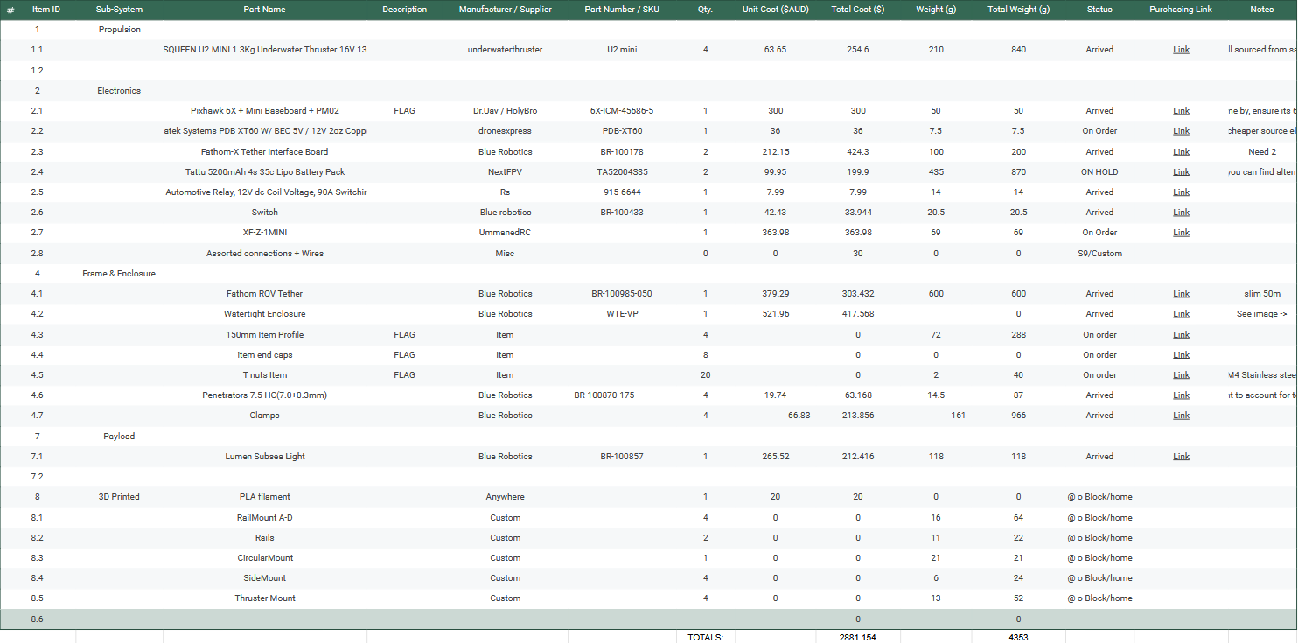
Condensed BOM

Slide 28
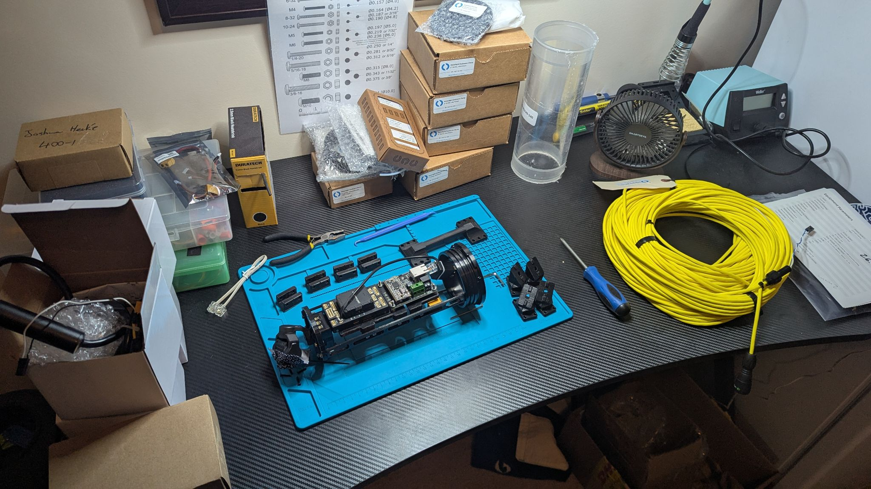

Slide 29
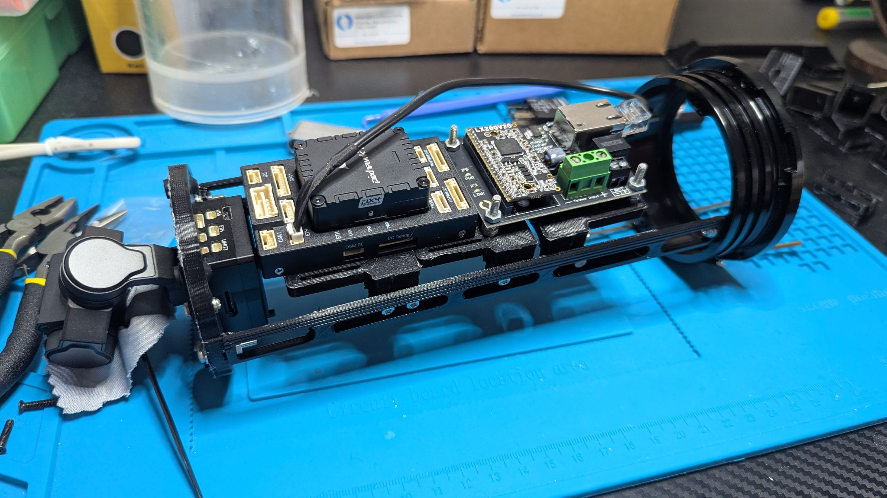

Slide 30



Project Outcomes and Broader Impact
Expected Outcomes:
A fully assembled and operational small-scale underwater ROV.
Complete Computer-Aided Design (CAD) drawings and a detailed Bill of Materials (BOM) for the final design.
Control system software with a camera view.
A final report detailing the design methodology, validation, and performance results.
Benefits & Impact:
Academic & Research: Creates a versatile, low-cost testbed for QUT demonstrations and future student projects, enabling hands-on learning in marine robotics, control systems, and sensor integration.
Future Innovation: Provides an adaptable platform for testing novel Machine Learning (ML) control pipelines, serving as a foundation for more advanced research.
Sustainability: Delivers a long-term, economically sustainable asset through a modular and repairable design using COTS components, maximizing the return on investment and ensuring knowledge transfer to future teams.
Notes:
2 sets of slides

Slide 31
Conclusion and Future Directions
Future Work: The start of Phase 2
Assembly & System Integration This phase involves the complete physical assembly of the ROV frame and the integration of the internal electronics tray, including the Pixhawk 6X, PDB, and Fathom-X boards.
Key tasks include flashing the ArduSub firmware , designing buoyancy modules based on the final mass , and simulating the ROV in ROS2/Gazebo to validate the control algorithms prior to physical testing.
Phase 1 complete:
literature review, CAD mechanical design, and component procurement are finalized.
The 4-thruster vectored configuration is optimized for size and power, with a 30-minute theoretical runtime confirmed by power budget analysis.
With most components on hand, the project transitions from theoretical design to physical assembly and integration.

Slide 32
Any Questions?
References
Hur, B., & Alvi, M. (2022). Educational Small Scale Underwater Robot Development via a Capstone Project in Engineering Technology. ASEE Annual Conference and Exposition, Conference Proceedings.
Jothikrishna, K., Rithika, S. M., Swetha, S. V., & Kavitha, K. (2023). Remotely Operated Underwater Vehicle (ROV). 2023 2nd International Conference on Advancements in Electrical, Electronics, Communication, Computing and Automation (ICAECA), 1–4. https://doi.org/10.1109/ICAECA56562.2023.10200265
Manos, N., Kavallieratou, E., & Vasilopoulos, N. (2024). Kalypso: An inspection AUV for aquaculture. Probe - Fishery Science & Aquaculture, 6(1), 2239. https://doi.org/10.18686/fsa2239
Sabri, W. M. A. B. W., Zabidi, I. R., Musthalib, M. A. M. A., Muhamad, Z. A., Hazman, M. I. M., Yusof, M. S. M., Naing, L., & Abidin, Z. Z. (2017). Low-cost remotely operated underwater vehicle for underwater observation purposes. 2017 IEEE 7th International Conference on Underwater System Technology: Theory and Applications (USYS), 1–5. https://doi.org/10.1109/USYS.2017.8309444
Wang, W., Pang, S., Wu, T., & Han, B. (2019). ArduinoSub—A Low-Cost ROV Kit for Ocean Engineering Education. OCEANS 2019 MTS/IEEE SEATTLE, 1–6. https://doi.org/10.23919/OCEANS40490.2019.8962404

